Slide 1
National Financial Crime Workplan
Ian McDonald, Senior Policy Adviser
26th February 2025

Slide 4
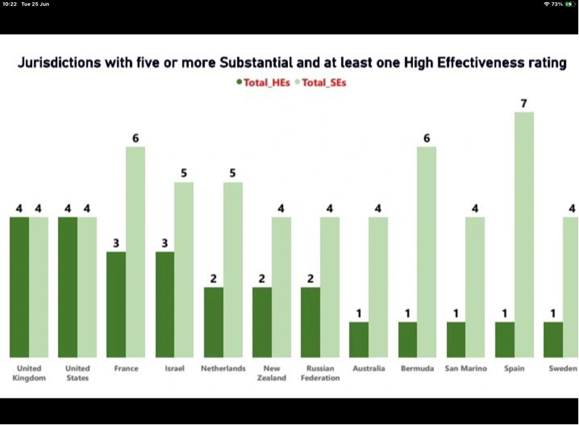
Global Comparison

Slide 6
5 Key Messages
High-Level of Compliance with International Standards
Confidence and Trust
Risk Understanding and Beneficial Ownership
Jersey obtains a rare rating, held by only 3 countries worldwide, of a HIGH Level of effectiveness for risk understanding and national co-operation/co-ordination
Accuracy and transparency of beneficial ownership information for legal persons and arrangements is praised by the assessment team - wide range of mitigating measures in place to reduce risk such as risk assessment, ongoing vetting of information and Registry supervision which occur in few other countries around the world.
4. Recommendations for improvement
Supervision
Preventative Measures
Financial Intelligence
Investigation & Prosecution
5. Foundations for growth

Slide 9
High Level Action Areas – JFSC & Registry
Review & update guidance
Review & Enhance data collection
Review Supervisory practices, including sanctions
Obliged Entity access (with discrepancy reporting)

Slide 10
High Level Action Areas - FIU
FIU transformation project
Review & Improve SAR intake and analysis
Review & Improve dissemination processes
Improve Strategic Analysis

Slide 11
High Level Action Areas – Law Enforcement Agencies
Data collection & monitoring
Alignment with risk
Training & capacity building
TF Outreach

Slide 12
Government Actions
Coordination (Working Groups)
Monitoring (Oversight Committees)
Risk Understanding

Slide 13
Break

Slide 14
Proliferation Financing
Ian McDonald
Financial & Professional Services Team

Slide 15
Overview of an AML/CFT/CPF regime

Slide 16
Illicit Financial Flows

Slide 17
PF Flow diagram

Slide 18
Proliferation financing often exploits global financial and corporate infrastructures
Activities include
Exploitation of corporate services providers (e.g., shell/front companies)
Use of local banks to access the financial system vs. international banks to move funds
Use of diplomats and embassies to access bank accounts abroad
Use of third country financial institutions (especially PRC)
Use of joint ventures and use of third country intermediaries
Bulk cash / gold smuggling and barter systems
Aliases
Targeting regions with weak monitoring and oversight (regulatory arbitrage)

Slide 19
The different forms of Proliferation Financing
Trade in
Goods & Tech
Revenue Raising Activities
Financial and corporate infrastructures
Notes:
The financial products and services associated with trade in goods that are directly usable or modifiable for use in the development of WMDs.
The activities that generate revenue to finance the procurement and development of WMDs can be legal or illicit
Any kind of corporate or financial infrastructure that facilitates activities included in the above two categories, as well as any assets or financial services provided to individuals or entities subject to targeted financial sanctions.

Slide 20
Revenue Raising – Legal (ish)
Restaurants
Building & Construction
Export of goods (food, textiles)
Luxury Goods
Minerals/Natural Resources
IT Services

Slide 21
Revenue Raising - Illegal
Wildlife Trafficking
Labour Exploitation
Arms Sales
Cyber Crime
Smuggling
Counterfeiting
Fraud

Slide 22
The Lazarus heist: How North Korea almost pulled off a billion-dollar hack
In 2016 North Korean hackers planned a $1bn raid on Bangladesh's national bank and came within an inch of success.
It all started with a malfunctioning printer, hacked
over a weekend
After a reboot the bank received instructions to wire
Funds to “The Fed”.
But the account info was actually a bank in Manila – linked to multiple accounts
Notes:
They planned to steal $951m - almost the entire contents of Bangladesh Bank's New York Fed account.
Only caught by a PF related fluke – the name of the bank was Jupiter Bank (on Jupiter Street in Manila) but Jupiter is also the name of an Iranian vessel!!
Managed to get away with $81m – laundered through Casinos in Macau (a Chinese territory)
Thye tried to steal

Slide 23
Crypto Theft
North Korean hackers have stolen $1.5 billion in cryptocurrency in a single heist, making it the largest crypto hack on record
The hack hit Bybit, which describes itself as the world’s second-largest cryptocurrency exchange, with over 40 million users.
DPRK spent last weekend laundering about $160 million of the stolen funds through a series of accounts connected to North Korean operatives.
In a single hack, the North Koreans have nearly doubled what they stole in crypto last year

Slide 24
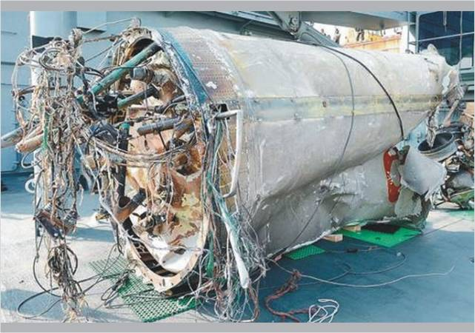
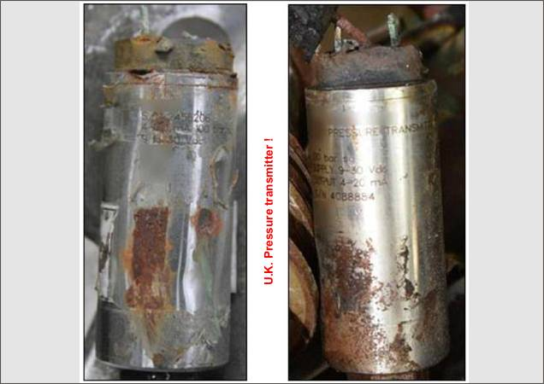
Story of North Korea (DPRK) Unha-3 Rocket Debris and Foreign-Sourced Components
Pressure Transmitters
Sourced from the
United Kingdom
Missile Launch Unha-3 Rocket (2012)
Recovery of Missile Remains
Notes:
As an introduction to proliferation and proliferation financing, let’s examine an actual event involving both proliferation and proliferation financing that has been well documented by the UN team responsible for the North Korean sanctions regime.
In December 2012, North Korea launched a long-range missile known as the Unha-3 rocket.
The wreckage of the Unha-3 rocket was recovered from the sea by South Korean authorities and was found to contain components sourced from a British company. The British company was not aware its products were being sent to North Korea.
These pressure transmitters were purchased by a Taiwan-based company who had them shipped from the UK to Taipei.
The Taiwanese-based company HAND CARRIED them to North Korea via flights to China where they were delivered to a North Korean company.
The North Korean company paid for one of these pressure transmitters in a bank transfer and the other was paid through off-setting transactions with another Taiwanese company to disguise the source of payment.
This is an example of the proliferation and proliferation financing activities that the UN and FATF are working to disrupt and impede.

Slide 25
DPRK procurement network involving father’s and son’s companies in Taiwan and US
Notes:
Key Points
A small family company was involved: family members were connected with the state through which goods and materials were being diverted (trans-shipped);
The network was resilient: despite designation of the main figure (Individual 1) and two of his companies, the network adapted by creating additional companies, and expanded its proliferation and non-proliferation trading activities;
It is not clear how the network was financed by KOMID. At least one cash transfer may have taken place in Singapore;
The network was also used for non-proliferation-related business (including procurement to the US).

Slide 26
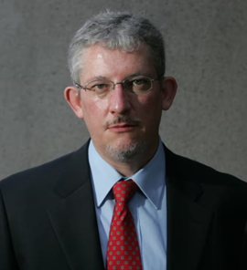
Daedong Credit Bank and DCB Finance Limited
Daedong Credit Bank was sanctioned & correspondent accounts closed
“DCB Finance Limited” was set up to carry out international financial transactions with Mr. Kim Chol-sam and Nigel Cowie as directors
It was registered in the BVI by legal firm Mossack Fonseca (was also operating in Jersey until 2016) operating under the latter’s name, masking Daedong Credit Bank’s involvement and thus DPRK’s
DCB Finance assisted Daedong Credit Bank in completing financial transactions with foreign companies seeking to avoid doing business with North Korea to protect their reputation

Slide 27
Embassies & Diplomats
Notes:
Discussion re. Chinese Embassy in Seychelles

Slide 28
North Korea’s Embassies and Diplomats
North Korea’s embassies also engage in illicit, non-diplomatic activities.
Earn and move foreign cash on behalf of the regime
Subsidize low wages of diplomatic staff
Make business connections and act as financial access points
Act as representatives of North Korean companies
The operations of North Korean diplomats are not limited to the countries in which they are based.
Diplomats attached to major DPRK embassies in Africa ( eg. in Pretoria or Dar es Salaam) have been known to cross regional borders and engage in illicit activities, such as revenue raising and cash smuggling.
Notes:
• In 2017 the UN imposed limits on the number of DPRK embassy bank accounts
• In 2019 the UN 1718 Committee Panel of Experts Report recommended that Member States designate a single bank to provide services to DPRK embassy staff
•DPRK diplomats not accredited to a Member States not be permitted to hold bank accounts in that country

Slide 29
Vulnerabilities in Africa
Military Cooperation – Angola (patrol boats; training)
- Ethiopia (ammunition supply)
- Namibia (construction of barracks)
- Mozambique (weapons upgrade & supply)
- Tanzania (missile systems upgrade)
- Zambia (border security services)
- Uganda (pilot training)
- Rwanda (special forces training)
Long history of military training and support in Zimbabwe

Slide 30
Why are statues sanctioned goods?
Country | Monument Name | Completion Year | Cost (USD)
Angola | Peace Monument | 2009 | 1.5 million
 | Antonio Agostinho Neto Cultural Centre | 2009 | 40 million
 | Cabinda Park | 2008 | 13 million
Botswana | Monument to the Three Dikgosi | 2005 | 1.7 million
Mozambique | Samora Machel Statue | 2011 | 0.7 million
Namibia | Presidential Palace | 2008 | 49 million
 | National Heroes’ Acre | 2002 | 5.23 million
 | Military Museum | 2004 | 1.8 million
 | Independence Memorial Museum | 2014 | 10 million
Zimbabwe | National Heroes’ Acre | 1981 | 60 million
 | African National Union Patriotic Front Building | 2014 | 5 million
Notes:
North Korean Mansudae Overseas Construction engaged by several national governemnst throughout Africa to build monuments, memorial parks, and commemorative buildings. This generate revenue for DPRK

Slide 31
DPRK Bank Accounts in Africa (and maybe a bank!)
The UN PoE reports have referenced bank accounts held by North Korean nationals or entities in
Namibia,
Zambia,
Zimbabwe,
South Africa (unconfirmed).
North Korean company MKP also appears to be operating a bank in Zambia.
Notes:
It is safe to assume that North Korean-linked bank accounts likely exist in any country that hosts North Korean businesses, allowing them to access the formal financial system.

Slide 32
And the list goes on….
Corporate entities – MKP Group; KOMID; MOP; Green Pine Associated Corporation (Green Pine);Korea General Corporation for External Construction (GENCO/KOGEN)
Construction workers (sometimes pretending to be Chinese)
Wildlife Trafficking
Porous Borders - Ethiopia, Madagascar, Malawi, Mozambique, Rwanda, Seychelles, Tanzania and Uganda allow North Korean passport-holders to enter their countries with visas granted on arrival.

Slide 33
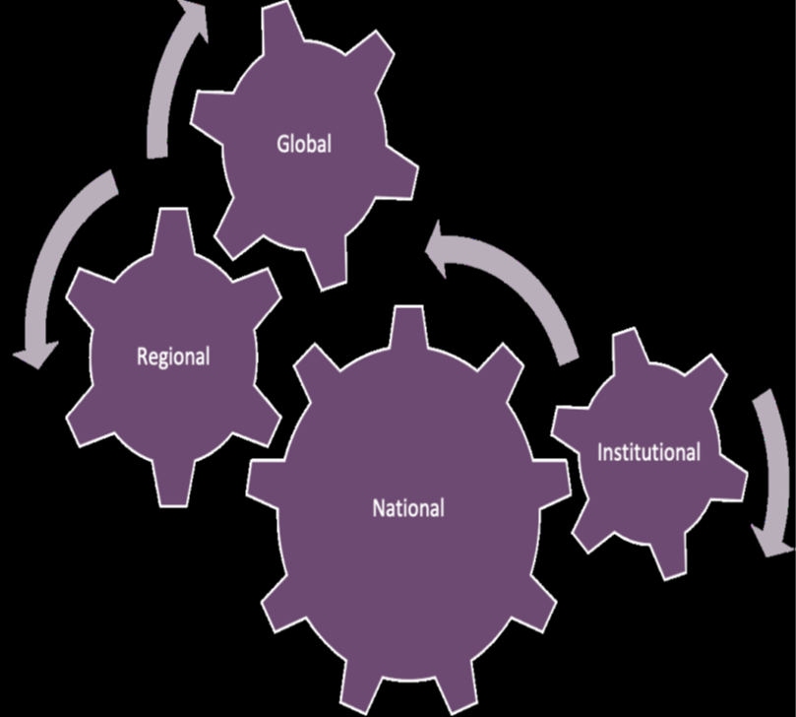
Key takeaways about proliferation financing

Slide 34
1. FATF Standards – Rec. 7 & IO11

Slide 35
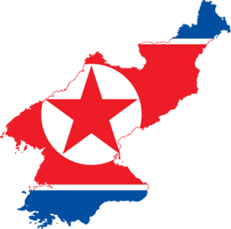
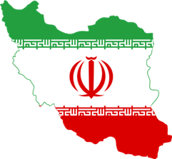
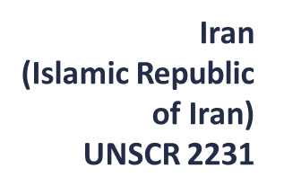
FATF Standards – Recommendation 7
Notes:
Recommendation 7 requires countries to implement targeted financial sanctions to comply with the UNSCR relating to the prevention, suppression and disruption of proliferation of WMD and its financing.
It should be emphasized that the requirement to apply targeted financial sanctions in accordance with Recommendation 7 is not risk-based, but rule-based.
This means that all countries are required to implement UNSCRs regardless of their level of proliferation financing risks in their countries.
The key objective for Recommendation 7 is that countries are required to:
freeze immediately the funds, other financial assets and economic resources which are on their territories or under their jurisdiction at the date of adoption of the resolution or at any time thereafter that are owned, controlled, directly or indirectly by the persons or entities designated by the UNSC.
Make sure that no funds or other assets and economic resources are made available to such persons and entities.
implement all targeted financial sanctions under PF-related UNSCR resolutions without delay
The focus of Recommendation 7 is on preventive measures to stop the flow and use of funds or other assets to proliferators or proliferation.
For Recommendation 7:
While designation decisions are made by the UN Security Council, countries should identify competent authorities for identifying and proposing designations.
Countries should undertake measures and safeguards to ensure freezing and prohibiting dealing in funds or other assets of designated persons and entities
Establish mechanisms to communicate with FIs and DNFBPs.
Monitor FIs and DNFBPs for compliance and require them to report frozen funds.
Establish de-listing procedures.
Ensure there are domestic cooperation and coordination mechanisms under R.2.

Slide 36
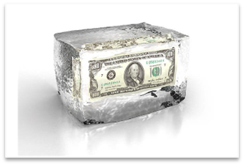
FATF Standards - Immediate Outcome 11
Notes:
The characteristics of an effective system within the IO11, are:
Targeted financial sanctions are fully and properly implemented without delay;
Funds or other assets are identified and frozen to prevent designated persons and entities from operating or from executing financial transactions related to proliferation
Financial institutions, DNFBPs and VASPs are effectively complying with, and understand their obligations regarding targeted financial sanctions relating to financing of proliferation
Targeted financial sanctions are monitored for compliance
Relevant competent authorities are effectively monitoring and ensuring compliance by financial institutions, DNFBPs and VASPs with their obligations regarding targeted financial sanctions relating to financing of proliferation
There is adequate co-operation and co-ordination between the relevant authorities to prevent sanctions from being evaded

Slide 37
FATF Guidance
The 2018 guidance is set out in 4 parts:
Implementation of targeted financial sanctions
Implementation of targeted financial sanctions Implementation of other measures included in UNSCRs
Interagency cooperation and coordination
Supervision and monitoring of compliance
Notes:
For the case you need to improve your knowledge in this topic, FATF have published two important guidance's regarding PF, which you will find at published at the website.
Implementation of targeted financial sanctions
Includes guidance on implementation of UNSCRs as required under FATF Rec 7 and IO 11
Information on how the designation process works and also how delisting is handled in the UN context
Examples of things to look for in detecting sanctions evasion activity (relevant to Rec 2 coordination to combat PF)
Implementation of other measures included in UNSCRs
Includes guidance on UNSCR measures that related to PF but go beyond Rec 7 (eg. activity based financial sanctions)
Information on other measures that are not required by Rec 7 but for part of the UNSCR sanctions regime such as activity-based financial prohibitions, vigilance and other types of financial measures and economic/sectoral sanctions
Interagency cooperation and coordination
Includes material on creating cooperation mechanisms in line with Rec 2
Advice on, and examples of domestic coordination
Agencies involved include:
Customs/border control agencies
Intelligence services
FIUs
Law enforcement and prosecution agencies
Financial supervisors and competent authorities
Trade and investment agencies
Relevant policy departments
Agencies involved in implementation
Supervision and monitoring of compliance
Includes information to assist competent authorities to exercise oversight of private sector implementation of PF measures (relevant to Rec 2, 7 and IO 11)
Advice on, and examples of monitoring and supervision.
The Guidance also has a section that summarises the indicators of proliferation financing activity that has been gathered through the 2008 FATF Typologies Report on Proliferation Financing and various reports of the UN Panel of Experts on Iran and DPRK. This is a useful summary that can be used to explain what proliferation financing activity looks like in communications with the private sector and within government.
I recommend reading this document in more detail as it contains a lot of valuable information on proliferation financing and clarifies what is required by Rec 7 in relation to TFS and what the other financial prohibitions in the UNSCRs are.

Slide 38
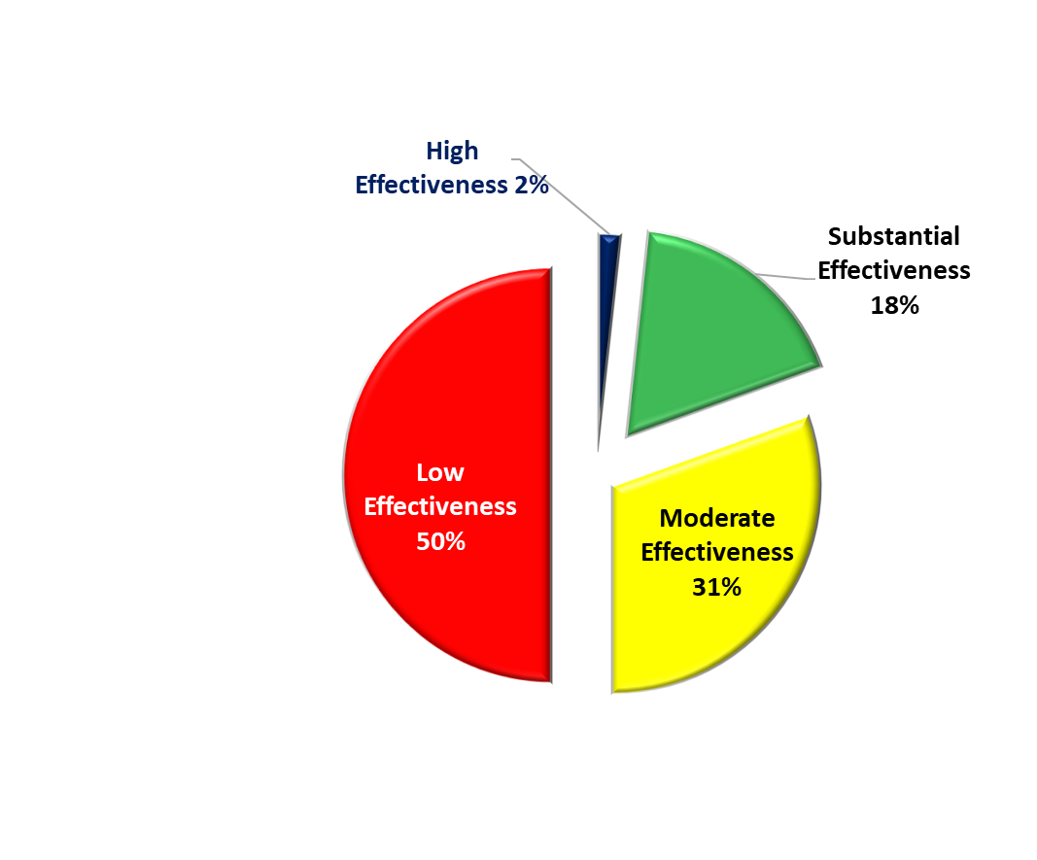
Current Ratings Results

Slide 39
Question Time

