Slide 1
Jill Britton, Director General
Jersey Compliance Officers Association
17 January 2025

Slide 2
Agenda
Who is who?
A look back on 2024
Looking ahead in 2025
Strategic refresh 2026+
Q&A

Slide 3
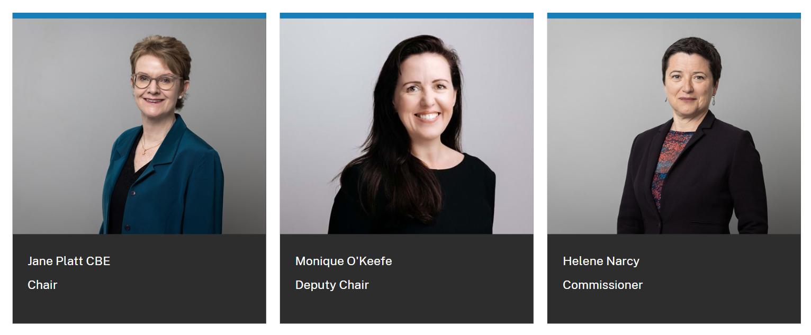
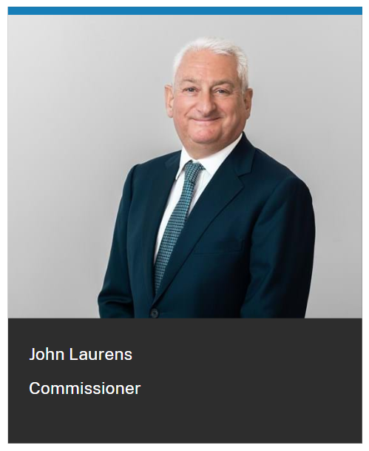
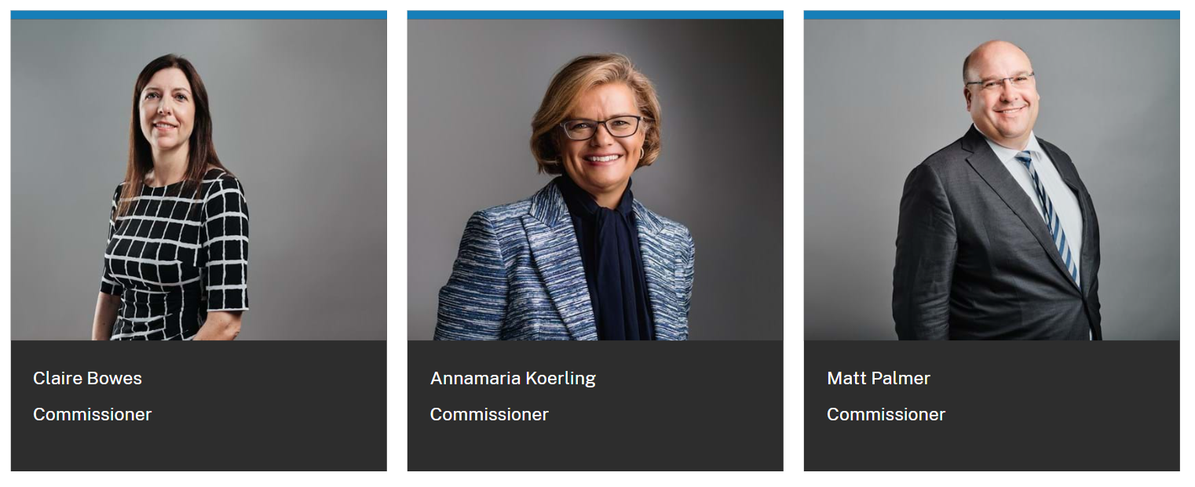
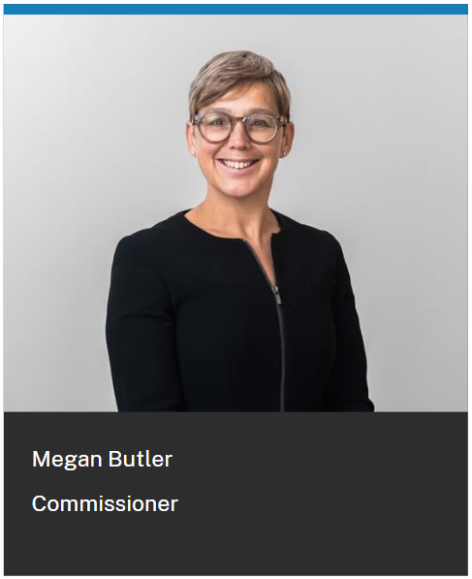
Board of Commissioners
Notes:
BoC photos.

Slide 4
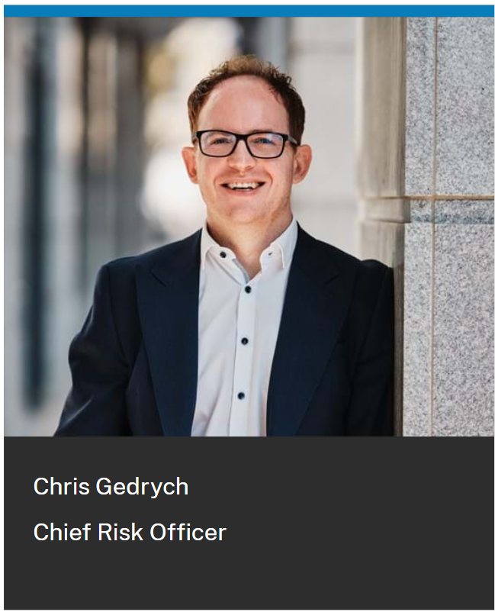
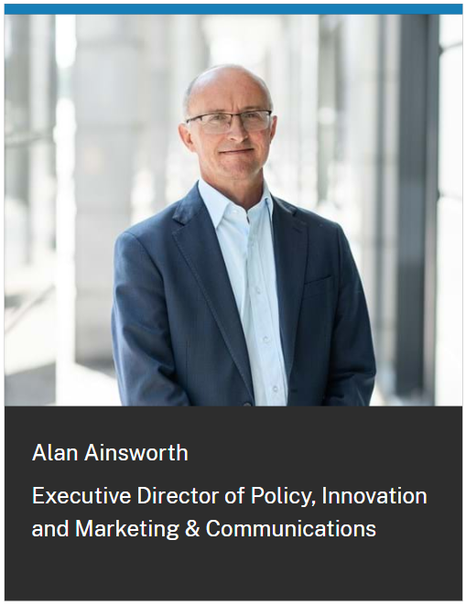
Executive Directors
Notes:
Exec photos

Slide 5
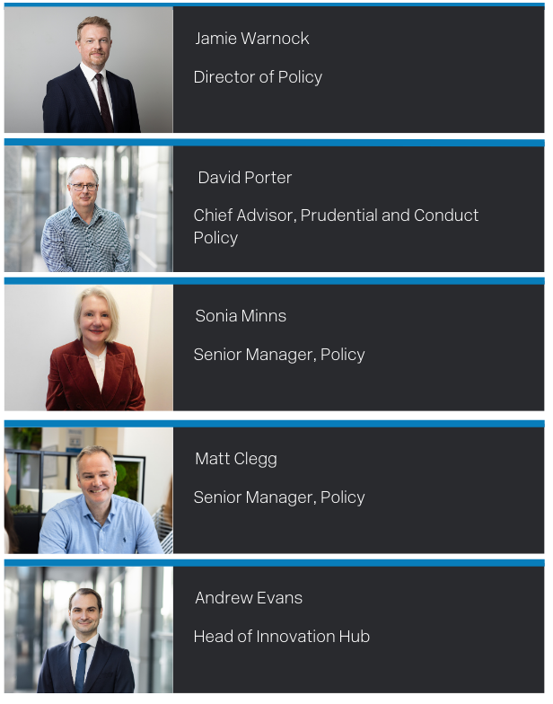
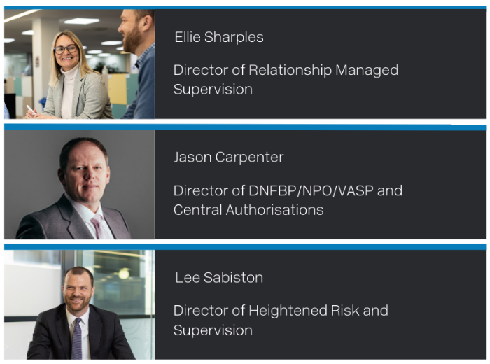
Leadership Group – key contacts
Policy and Innovation Hub
Supervision
Risk
Notes:
PDF.

Slide 6
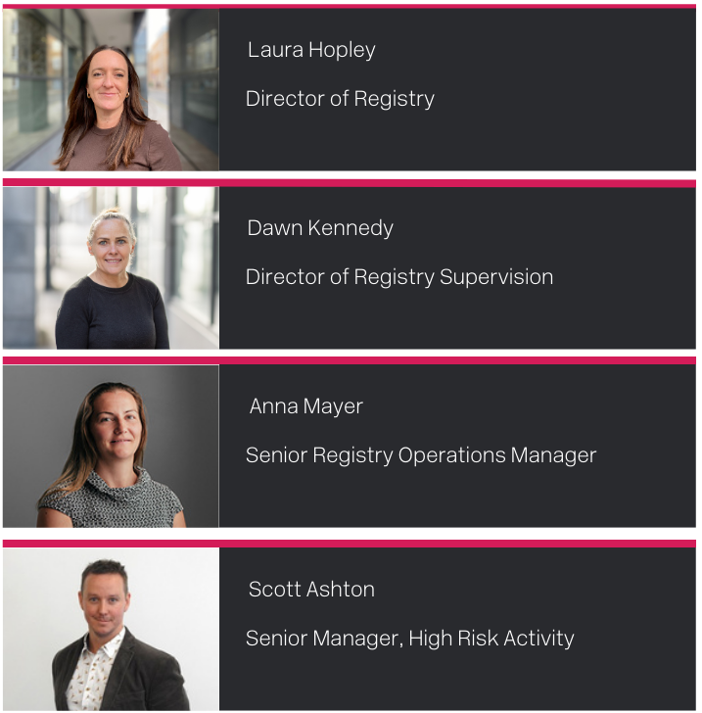
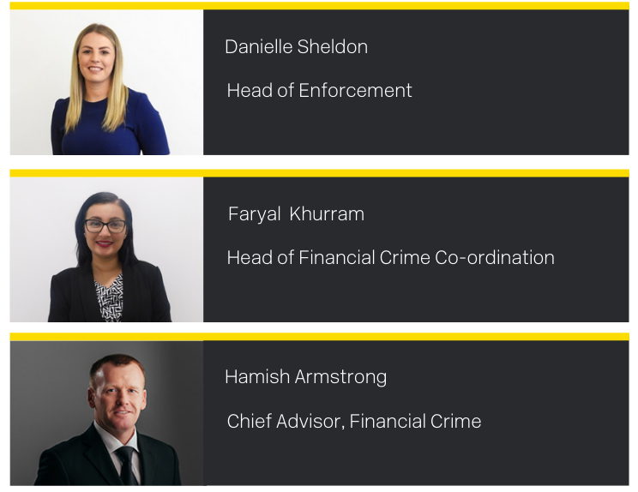
Leadership Group – Key Contacts
Registry
Enforcement and Financial Crime
Notes:
PDF.

Slide 7
Headcount 2025
Division | Headcount | Changes to Jan 2024
Enforcement, Financial Crime and Intelligence | 27 | -1
Technology and Data | 24 | +1
Office of DG (inc. Commissioners) | 19 | -1
People and Culture (inc. Students) | 11 | +4
Finance and Change | 18 | 0
Policy, Innovation and Communications | 25 | +2
Registry | 43 | +7
Risk, Legal, Data Protection and Information Management | 9 | +1
Supervision | 99 | -1
Total | 275 | +12
Numbers represent headcount and not FTE FTE = 270.6

Slide 8
A look back on 2024….

Slide 9
2024 in numbers
2858
1,373
54
13
1018
130
101
£335k
Notes:
QUIZ
54 = Whistleblowing Calls
130 = External Policy Queries
1,373 = Intelligence Information
£335k = L&D
101 = Examinations
13 = Innovation Hub Publications
2858 = new entities incorporated

Slide 10
Strategic development
Vision
To be a high-performing regulator, building for the long-term, success of Jersey.
Top strategic priority
Achieving sustainable, long-term excellence in regulatory effectiveness, and increased capability for the island in combatting financial crime.
Strategic anchors
Three strategic anchors provide the lens through which we make our decisions:

Slide 11
Strategic development
Facilitating business integrity
Facilitating business integrity involves supporting businesses to: reach greater maturity in risk management improve their understanding of regulatory standards adopt an active approach to compliance
Harnessing technology and influencing adoption
We aim to enhance our own digital capabilities and technology usage while promoting and supporting technology adoption across the financial services industry. Our goal is to create an environment where digitalisation can thrive without facing unintended regulatory barriers.
Developing our people, systems and capabilities
Our goal is for our team to have the support, systems, equipment, training and structure they need to thrive and to deliver a quality service to our stakeholders. This includes attracting and retaining talented employees through a strong employee value proposition and ensuring our systems and processes are fit-for-purpose.

Slide 12
Facilitating business integrity
Outcome:
Successful MONEYVAL mutual evaluation
Enhanced financial crime capability embedded into business-as-usual activity
Developed conduct and prudential focus
Issues revised JPF Guide
Asset tokenisation and initial coin/token guidance published
Green paper issued on changes to the Key Person regime

Slide 13
Harnessing technology and influencing adoption
Outcomes:
Addition of 5 forms to myJFSC
Strengthened cyber security controls, achieving ISO27001 and Cyber Essentials Plus
Launched ‘Reggie’ – AI-powered regulatory assistant
Developed systems to provide obliged entity access to beneficial ownership information
Completed core upgrade of Registry system to enable future improvements to user experience

Slide 14
Developing our people, systems and capabilities
Outcomes:
Established Operational Excellence team focused on continuous improvement
Independent expert review of user experience of Registry
Outsourced internal service desk to local third party to increase capacity in IT
Employee turnover maintained at significantly reduced levels from 2021, with focus on supervisory training
Risk and control framework strengthened, including sharing of sector specific data to support internal and industry understanding and analysis of risk

Slide 15
Looking ahead in 2025…

Slide 16
Facilitating business integrity
Actions:
Implementation of MONEYVAL action plan
Laying the groundwork for a new Consumer Credit regime to protect consumers
Advancing recommendations from independent fees review to support competitiveness
Supporting delivery of the Government’s sustainable finance action plan to provide certainty and effectively position Jersey
Support the Government’s Strategic Review of the Regulatory Environment to simplify regulation and support competitiveness

Slide 17
Harnessing technology and influencing adoption
Actions:
Conducting a strategic review of Registry to enhance Jersey’s standing as a jurisdiction of choice
Implementing a new data strategy to simplify data collection processes and enable sharing of greater insights
Improving user experience to our digital platforms, including new online forms, website improvements and simplification of guidance
Developing the technology and organisational capability to operate new primary legislation for trademarks and intellectual property registers
Hosting technology and innovation workshops with industry to identify and align on shared opportunities for digital improvement

Slide 18
Developing our people, systems and capabilities
Actions:
Reduce and consolidate physical technology footprint to manage costs and support ESG
Upgrade core financial management system
Progress plans for office relocation
Increase focus on operational performance improvement, measurement and reporting to improve SLA’s and stakeholder experience

Slide 19
Divisional focus
Supervision examinations
Thematic examinations
Conflicts of interest (Q1)
Suspicious activity reporting (Q2)
Outsourcing (Q3)
Thematic assessment visits
Banking = fraud (Q1)
IB = fees, charges and commissions (Q2)
Authorisations – AMLSP’s (Q2)
FSB/TCB = transaction monitoring (Q2)
Accountants = customer risk assessments (Q2)
NPO’s – terrorist financing (Q3)
VASP’s – travel rule (Q3)
Policy priorities
Key Person regime
Sustainable finance
Consumer lending
Legitimate Interest (Registry)
Basel III
Companies Law amendments
Criminality checks (MV action)
APP fraud
Schedule 2 – guidance review
MONEYVAL actions and handbook enhancements

Slide 20
Q1 priorities
2024 Examinations feedback papers – PEP thematic, IB suitability and legal sector
Annual fees run
Green paper feedback – Key Person regime
Supervisory data collection
Supervisory data reports – accountants, estate agents, funds and lending

Slide 21
Q1 priorities
Consultation – Authorised Push Payment Fraud
Consultation – Criminality Checks
Publish 2025 Business Plan and event on 11 February
Registry – annual returns
Registry – obliged person access

Slide 22
Strategic refresh 2026+
2025 will see us finishing what we started in the current strategy and laying the groundwork for the next.
We recognise the importance of providing stability for industry throughout this process. We will continue our engagement work and evolve in response to emerging themes.
The Government of Jersey’s current Strategic Review of the Regulatory Environment is timely, providing a valued opportunity for our Board to engage with stakeholders and receive feedback to shape our future approach.
Competitiveness will be a key focus as we advance our strategy for 2026 and beyond.

Slide 23
Subscribe to our news and updates
You can now keep up-to-date with all our latest news and updates.
Subscribe to receive regular email alerts directly to your inbox.
Notes:
Optional, please delete if preferred.

Slide 24
Questions?

