Slide 1
Financial Crime Threats: A Changing Landscape

Slide 2
Contents
Introduction
Threats: As Opposed to Risks
Complexity, Convergence and Chaos
Picture of Threat
Pig Butchering: A 21st Century Crime
Implications for Compliance
Key Takeaways

Slide 3
Speaker
Joby is a global subject matter expert on illicit finance and emerging threats. Joby has 20 years+ of experience and expertise in strategic policy making, critical thinking, threat and risk analysis across the U.K. Government, intelligence and regulatory community. In his previous role Joby was responsible for the management of the Financial Conduct Authority’s Strategic Assessment Team, overseeing a team of analysts tasked with delivering high quality intelligence reporting on money laundering, fraud, market abuse, corruption and other forms of criminality
Joby Carpenter
Global SME, Illicit Finance and Emerging Threats
ACAMS

Slide 4
Threats: As Opposed to Risks

Slide 5
Threats?
Risk-based approach remains the international gold standard approach
Governments and law enforcement conduct threat analysis
Threats inform the broader process of risk management
It must be intelligence led
Threats are receiving more prominence from regulators
Threat analysis helps fill intelligence gaps
And demonstrates a commitment to tackle financial crime effectively
Join the dots…………………………………………

Slide 6
Complexity, Convergence and Chaos

Slide 7
Why So Tricky?
The world is more complex than at any point since the height of the Cold War
Financial crime has become a national security threat – competing with state driven threats
State actors, organised crime and multiple enablers are overlapping – and cooperating
Predicate crime can no longer be viewed in isolation
Longstanding risks (correspondent banking, trade-based laundering, investment visas etc) still exist
Financial institutions are still expected to do the day job
Where is the intelligence and what are the trade-offs?
Formerly compartmentalised subjects now require joined up approach (e.g. AML/fraud)

Slide 8
Picture of Threat

Slide 9
Scams/ Frauds
“Budget constraints, resource limitations, and IT investment emerged as the primary risks impacting the effectiveness of financial crime functions.”
Sanctions Evasion
Talent Retention
Cyber-enabled Crime & AI
Resource Allocation/Emerging Threats
Weapons proliferation
Transnational criminal smuggling
Outdated/ Legacy IT
Internal Challenges
AFC Threats
Organized Crime and Terrorism
International Terrorism/ domestic extremism
Human Trafficking
Exploitative Crimes
Geopolitics
Pig Butchering
Fragmenting trade

Slide 10
ACAMS Global Threat Report 2024
1. Economic Downturn & AFC Budget Cuts
2. Geopolitical Tensions
3. Cyber Enabled Fraud
4. Sanctions and
Sanctions Evasion
5. Scale/Pace of Change
If institutions cannot manage this threat, it will negatively impact their ability to manage all other threats in this report and the overall effectiveness of their AFC function.
Navigating this fragmented environment requires adept handling of emerging scenarios involving conflicts of laws/regulations, personnel risks, and market volatility.
Recent technological advancements have caused a rapid surge in cyber-enabled fraud, with governments increasingly viewing fraud as a national security threat.
Concerns stem from the use of sanctions for foreign policy objectives and the persistent complexity of maintaining ‘sanctions compliance.’
A significant dynamic, this influences the full spectrum of AFC programs and creates significant operational risks, particularly where AFC programs have already been stretched in recent years.

Slide 11
The Top Ten Threats: Summary Highlights
6. Abuse of Legal Entities
7. Counter Terrorist Financing
8. Lack of an Effective Risk-based Approach
9. Offensive use of tech
10. The Threat from within
There are renewed demands for corporate transparency globally, and authorities are anticipated to intensify efforts to enforce corporate registry structures and beneficial ownership due diligence requirements.
Maintaining the balance between counter terrorist financing and humanitarian assistance is challenging for the AFC community, as designated terrorist groups can often operate where humanitarian needs are greatest.
The lack of an effective risk-based approach to regulation and supervision is consistently viewed as a hinderance to the ability of AFC regimes to fight financial crime effectively.
Hostile use of commercial spyware, ransomware, and other offensive cyber capabilities is a significant risk – underground forums and the darknet continue to thrive.
This threat spans financial institutions’ internal operations, from criminals working with employees or contractors to circumvent AFC controls, to security implications from hybrid working.

Slide 12
Pig Butchering: The Epitome of a 21st Century Threat

Slide 13
“Organized crime groups are converging and exploiting vulnerabilities and the evolving situation is rapidly outpacing governments’ capacity to contain it.”

Slide 14
Pig Butchering
Pig Butchering
[pɪɡ ˈbʊʧərɪŋ]
noun
Pig butchering scams are virtual currency investment scams and are referred to as “pig butchering” as they resemble the practice of fattening a hog before slaughter. The victims are referred to as “pigs” by the scammers who leverage potential relationships, and elaborate storylines to “fatten up” the victim into believing they are in trusted partnerships. The scammers then refer to “butchering” the victim after victim assets are stolen.

Slide 17
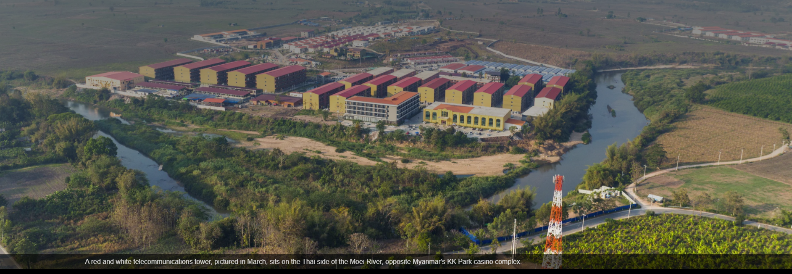

Slide 18
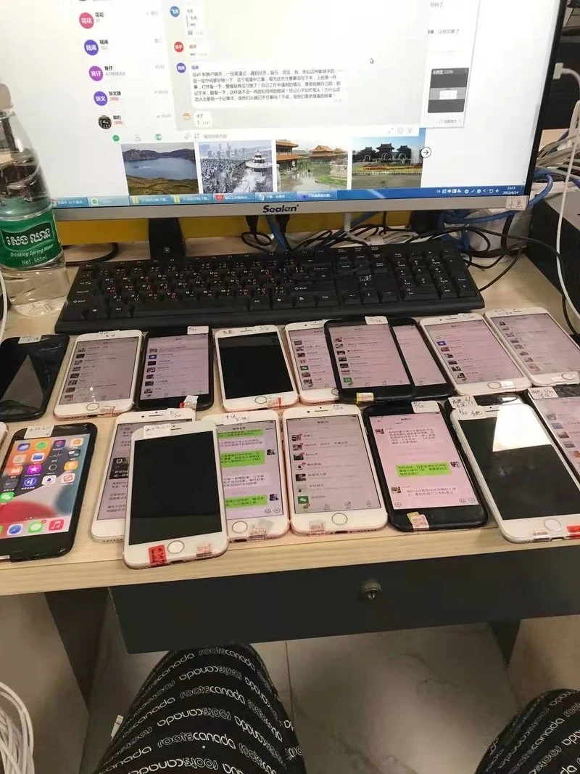
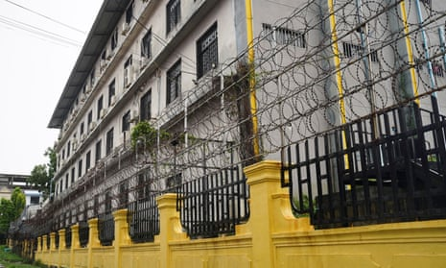

Slide 19
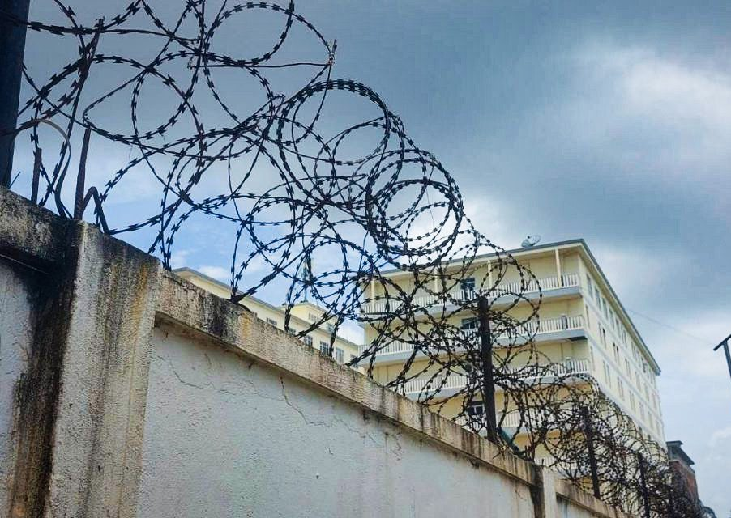
The Reality
Annual profits $43.8 billion
40% of Cambodia, Laos, Myanmar combined annual GDP
Slavery, torture and death
Linked to drugs, CSAM, weapons and cybercrime

Slide 20
Pig Butchering: AFC Controls and Mitigations
Financial institutions and VASPs are unwittingly used as a conduit to collect and transfer deposits from victims and are primarily used as the first intermediaries to launder money
Pig butchering schemes commonly involve victims withdrawing cash or initiating wire transfers to VASPs via their bank accounts
Criminal organizations employ money mules that open shell companies in the U.S., U.K. and elsewhere and create associated bank accounts and virtual asset wallets which victims send funds to
Generic controls and mitigating activities to identify pig butchering may include:
Implementing appropriate training for all relevant employees to increase awareness of suspicious activity related to pig butchering
Contacting recipients of outbound transactions to raise awareness of scams and seek clarity to ensure transfers are for legitimate purposes
Implementing behavioural analysis techniques to detect and report deviation from normal customer behaviour to mitigate risk and protect customers from becoming victims of frau

Slide 21
Implications for Compliance

Slide 22
How should anti-financial crime functions respond?
Training programmes, education and awareness for front line staff, compliance professionals, senior management and customers
Establish an open-source strategic intelligence function
Prove to regulators that you understand your exposure and associated risks
Join forces in public-private-partnerships
Integrate intelligence into mitigation controls

Slide 23
Key Takeaways
The financial crime threat is more acute and more complex than ever.
Regulators, policy makers and law enforcement are taking a more threat driven approach.
Proactively responding to high harm threats using OSINT is increasingly critical.
FIs must ensure they have the requisite resources and skills to leverage threat information.
Used correctly threat intelligence opens up opportunities to be proactive, take a lead generated approach to investigations and can predict/prepare for future threats.
Threat based information or intelligence can form a core part of taking an informed approach to decision making

Slide 24
The ACAMS Anti-Fraud Program
Our anti-fraud training for FIs and NBFIs, showcased on our "Fraud Hub”, provides access to a comprehensive suite of anti fraud-focused resources. These encompass a certification program (CAFS)*, certificate courses, webinars, events, and best-in-class journalism, all contributing to excellence in combating fraud.
The ACAMS Fraud Hub
Certification Program in Fraud Prevention
6 Fraud
Certificate
Courses
The CAFS**
Certification
Publications & Digital Content
Exclusive
Resources for
Members
Fraud
Webinars
Events
Complimentary
Consultation
Visit the CAFS page:
Visit the Fraud Hub:
*The Certified Anti-Fraud Specialist Certification (CAFS).
acams.org/cafs
acams.org/fraudhub

Slide 25
The ACAMS Anti-Fraud Program
Visit the Fraud Hub:
Visit the CAFS page:
acams.org/fraudhub
acams.org/cafs

Slide 26
Thank you! Any questions?

